Slide 1

Computational Neuroscience
CNN – part (2)
Edited by
A. Prof. Noha El-Attar

Slide 2
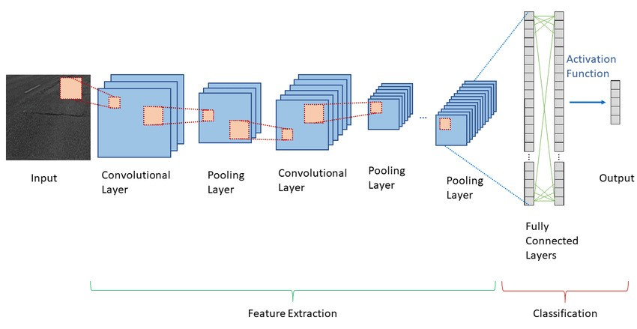
Convolutional Neural Network (CNN)- cont..
CNN consists of multiple layers:
Convolution Layer: that has several filters to perform the convolution operation.
Pooling Layer: a down-sampling operation that reduces the dimensions of the feature map, then converts the resulting two-dimensional arrays from the pooled feature map into a single, long, continuous, linear vector by flattening it.
Fully Connected Layer: The final feedforward NN for classify the flattened matrix that come from the pooling layer as an input.

Slide 3
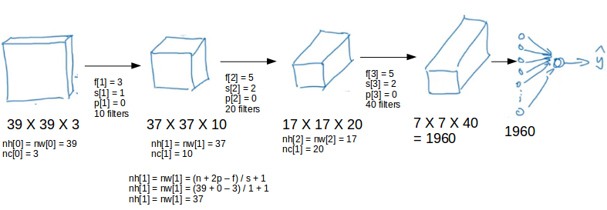
Simple Convolutional Neural Networks Example

Slide 4
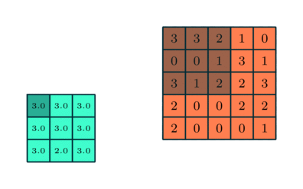
2. Pooling Layer
The Pooling layer is responsible for reducing the spatial size of the Convolved Feature. This is to decrease the computational power required to process the data through dimensionality reduction. Furthermore, it is useful for extracting dominant features which are rotational and positional invariant.
There are two types of Pooling:
  Max Pooling : returns the maximum value from the portion of the image covered by the Kernel.
  Average Pooling: returns the average of all the values from the portion of the image covered by the Kernel.
3x3 pooling over 5x5 convolved feature

Slide 5
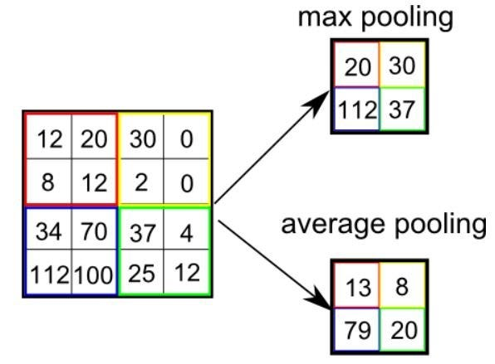
Which is better?
Max Pooling also performs as a Noise Suppressant. It discards the noisy activations completely along with dimensionality reduction. Average Pooling simply performs dimensionality reduction as a noise-suppressing mechanism.
Hence, we can say that Max Pooling performs a lot better than Average Pooling.
The hyperparameters for a pooling layer are:
  Filter size
  Stride
  Max or average pooling
If the input of the pooling layer is n_{h} X n_{w} X n_{c}, then the output will be [{(n_{h} – f) / s + 1} X {(n_{w} – f) / s + 1} X n_{c}].

Slide 6
Convolution Neural Network composition
The Convolution Layer and the Pooling Layer, together form the i-th layer of a Convolutional Neural Network. Depending on the complexities in the images, the number of such layers may be increased for capturing low-level details even further, but at the cost of more computational power.

Slide 7
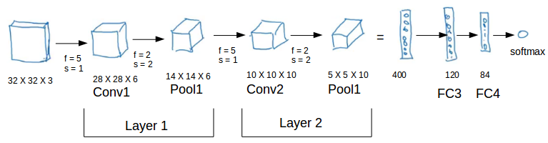
CNN Example: (Conv + pooling layers)
16
16

Slide 8
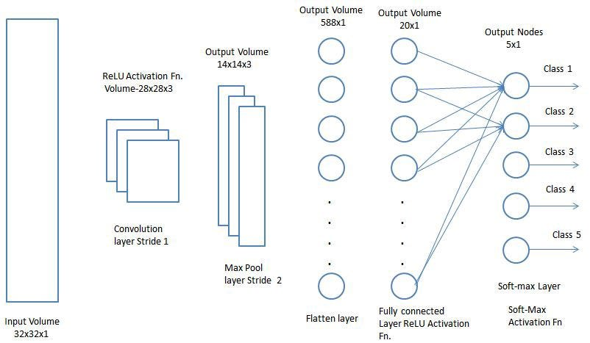
3. Fully connected layers
Fully-connected layers are one of the most basic types of layers in a convolutional neural network (CNN).
Each neuron in a fully-connected layer is Fully connected- to every other neuron in the previous layer (Flatten layer).
Fully connected layers take the features learned by the conv. and pooling layers and use them to make predictions such as classifying the input to a label.

Slide 9
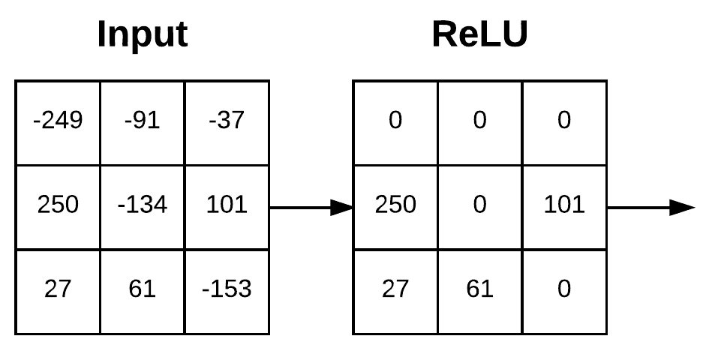
Activation Functions in CNN
ReLU or Leaky ReLU: after convolutional layer – to convert every negative value into zero.
2. Softmax or sigmoid: to do classification after the fully connected layers.
Softmax is the widely used activation function used in CNN.

Slide 10
Common Classic CNN Architectures
LeNet-5
AlexNet
VGG
ResNet
MobileNets
GoogLeNet

Slide 11
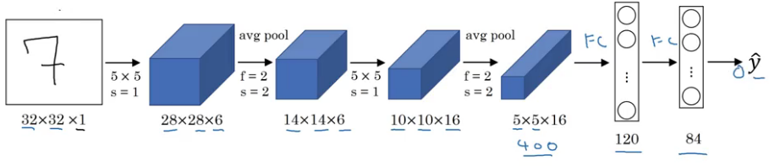
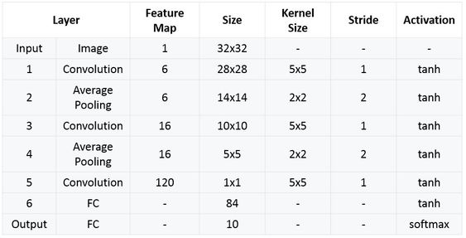
LetNet-5
It is one of the earliest and most widely-used CNN architectures and has been successfully applied to tasks such as handwritten digit recognition.
It takes a grayscale image as input.

Slide 12
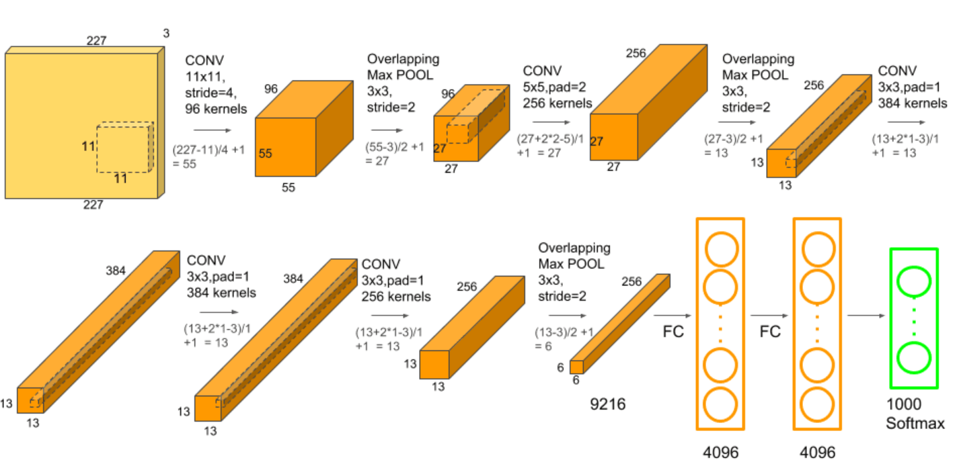
AlexNet
Mainly used for large scale colored images.
AlexNet is composed of 5 convolutional layers with a combination of max-pooling layers, 3 fully connected layers.

Slide 13
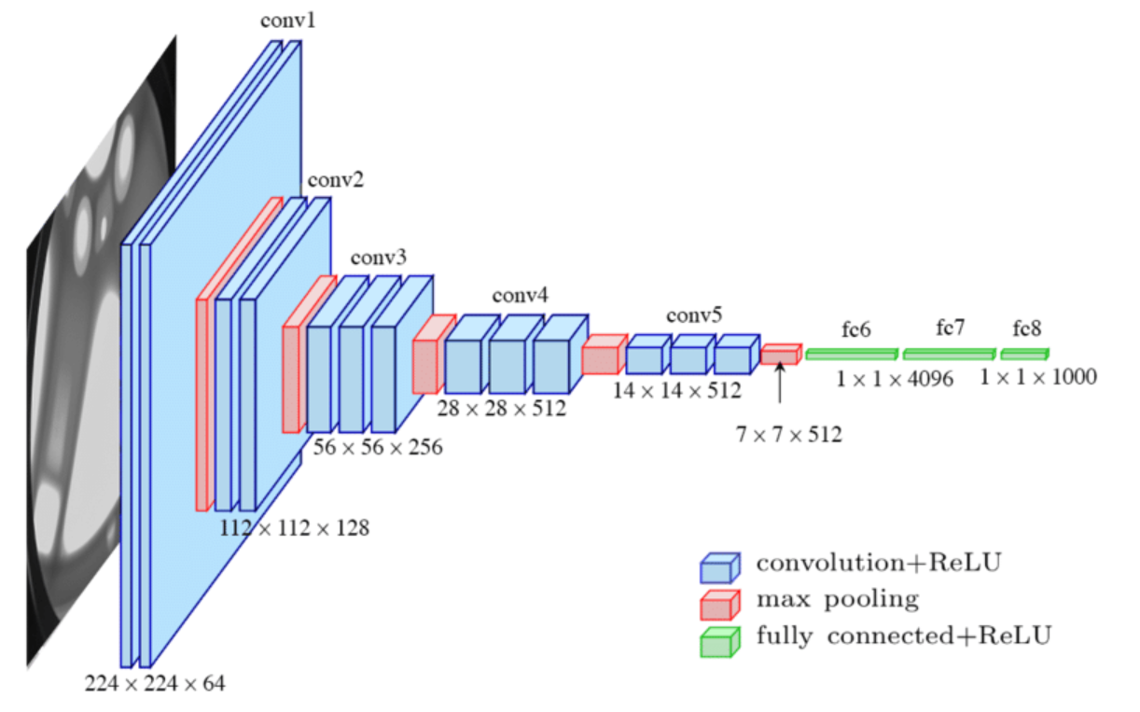
VGG16
The “16” in the name indicates that the model contains 16 layers that have weights; this includes convolutional layers as well as fully connected layers.
VGGNet is a 16-layer CNN with up to 95 million parameters and trained on over one billion images (1000 classes).
convolution layers that have 3 X 3 filters with a stride of 1.
The max pool layer is used after each convolution layer with a filter size of 2 and a stride of 2

Slide 14
Conclusion
Architecture | Year | Use Case
LeNet | 1998 | Recognizing handwritten and machine-printed characters
AlexNet | 2012 | Large-scale image recognition tasks
ZFNet | 2013 | ImageNet classification
VGGNet | 2014 | Large-scale image recognition
ResNet | 2015 | Large-scale image recognition, won 1st place in the ILSVRC 2015
GoogleLeNet | 2014 | Large-scale image recognition, won 1st place in the ILSVRC 2014
MobileNets | 2017 | Mobile and embedded vision applications, real-time object detection

Slide 15
Exercise:
if you have an input image matrix as follows:
R G B
112 | 125 | 25 | 80 | 220 | 110
150 | 95 | 15 | 100 | 115 | 152
200 | 100 | 48 | 90 | 70 | 175
187 | 56 | 43 | 86 | 180 | 200
190 | 87 | 70 | 37 | 24 | 35
80 | 75 | 65 | 45 | 32 | 20
150 | 125 | 38 | 80 | 20 | 10
130 | 95 | 25 | 100 | 115 | 152
80 | 100 | 148 | 90 | 70 | 175
170 | 160 | 43 | 160 | 170 | 180
100 | 150 | 70 | 37 | 124 | 135
85 | 75 | 65 | 45 | 232 | 120
200 | 125 | 25 | 80 | 220 | 150
50 | 95 | 15 | 150 | 115 | 152
90 | 110 | 48 | 190 | 70 | 175
180 | 135 | 43 | 106 | 180 | 110
55 | 98 | 70 | 37 | 24 | 35
78 | 150 | 65 | 45 | 32 | 80
By applying the following filter, with stride 2, and one layer padding.
1 | 1 | 1 | 0
0 | 1 | 1 | 1
-1 | 0 | 0 | 1
-1 | 0 | 1 | -1
0 | -1 | -1 | 0
1 | -1 | 1 | -1
1 | 0 | 0 | 1
1 | 0 | 1 | 1
1 | 1 | 1 | 0
-1 | 1 | 1 | 1
0 | 1 | 0 | 1
-1 | -1 | 1 | 1
1- calculate the output of the first convolution layer (Conv+ max pooling). Note that, the pooling kernel equal 2, with stride 2. Apply the ReLU activation function in its right place.
2. Draw the complete CNN and calculate the flatten layer size for 2 complete convolution layer:
1st conv. layer → filter = 4X4 , s= 2, p= 1
1st max pool layer → filter = 2X2, 2=2
2nd conv. Layer → filter = 3X3, s=1
2nd pool layer → filter 2X2, s= 2

